Slide 1
IBM Applied Data Science Capstone Project - The Battle of Neighborhoods (Week 2) Cities Divided by Iron Curtain new Opportunities
Miroslav Danek

Slide 2
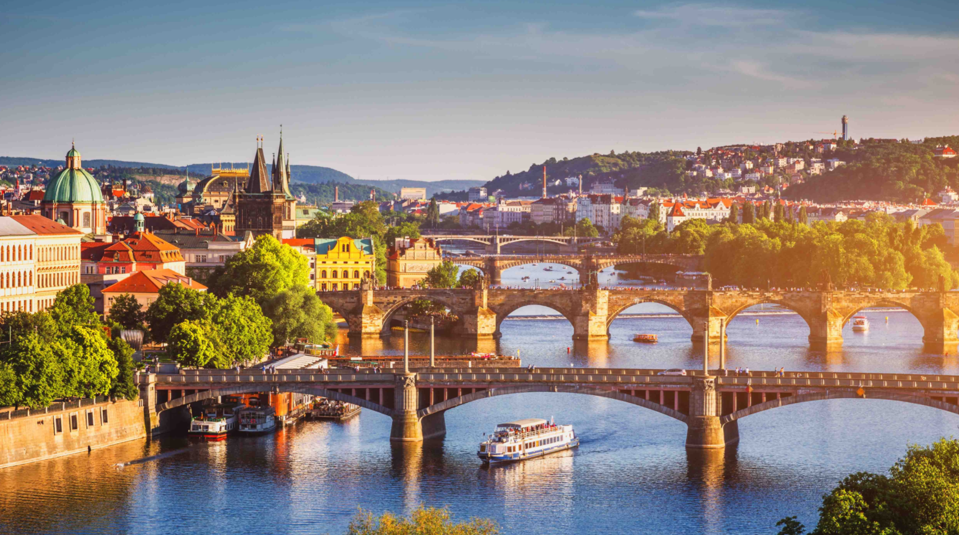
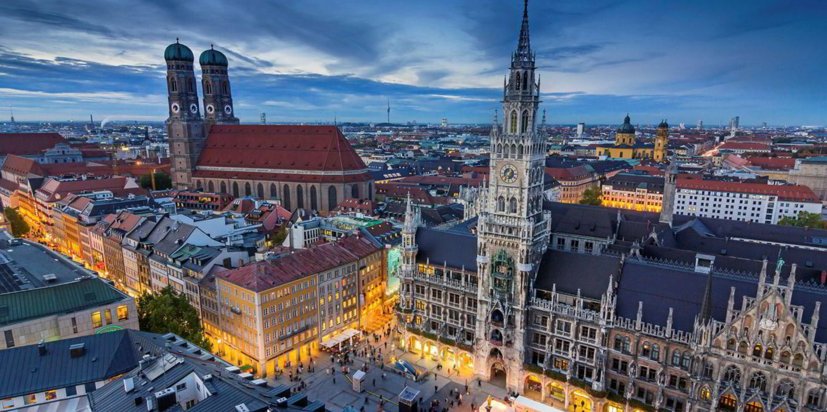
Prague vs Munich

Slide 3
Introduction/Business Problem
Prague and Munich are two similar cities, which were divided by iron curtain 30 years ago. This long separation has changed the evolution of the isolated city Prague dramatically.
It is nowdays possible to find some remaning differences using Datascience and to predict the future developement?

Slide 4
Business Problem
The comparison of these two cities using the methods of data science, could reveal some new business opportunities.
Probably in is some fields the convergence process of both cities not completed or in Munich are missing some venues which will come from the east in the future, as the relevance of the eastern economies will rise.

Slide 5
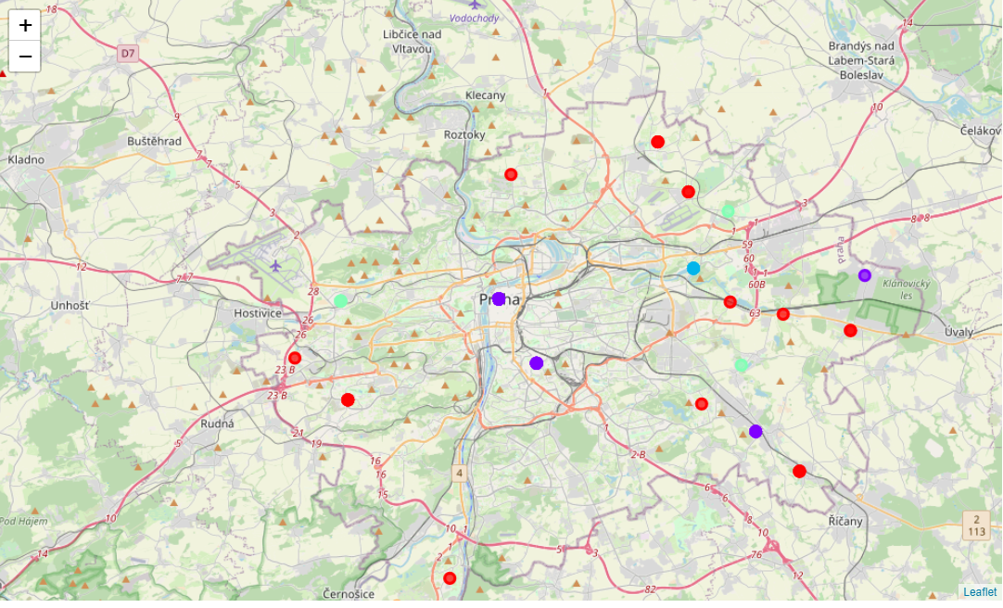
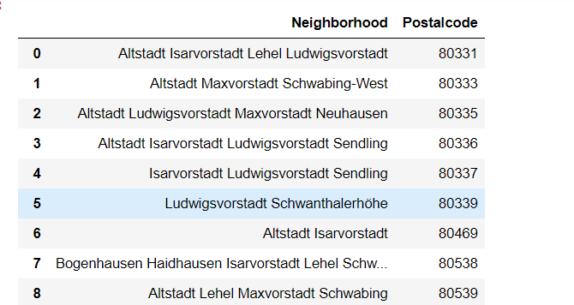
Data
ZIP Lists of both cities found on the internet.
Coordinates of all neighborhoods automatically assigned by an API.
Venue Data obtained from the Four Square API

Slide 6
Methodology
A public chart with neighborhoods and ZIPs will be scraped, cleaned and Coordinates will be added
Venues will be assigned to the neighborhoods using coordinates and the Four-square API
5 Clusters of neighborhoods will be created using the k-means method.
The data of both cities will be compared and vizualized

Slide 7
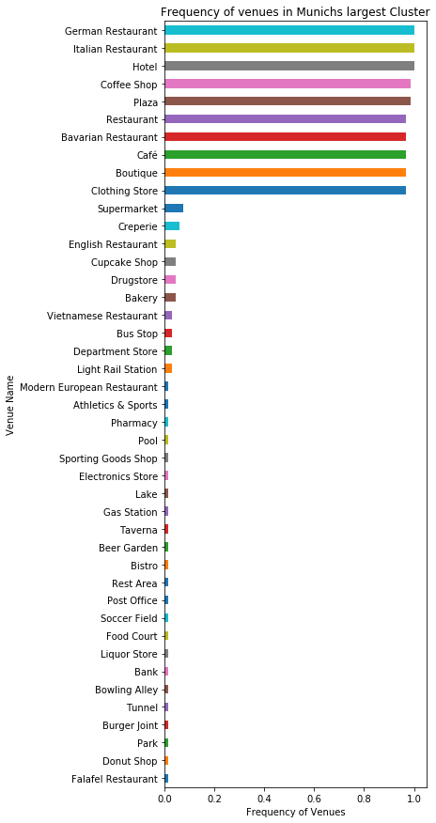
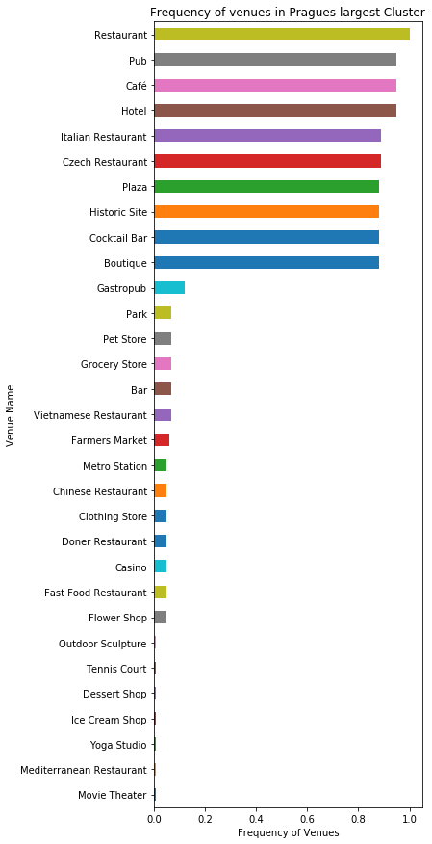
Results

Slide 8
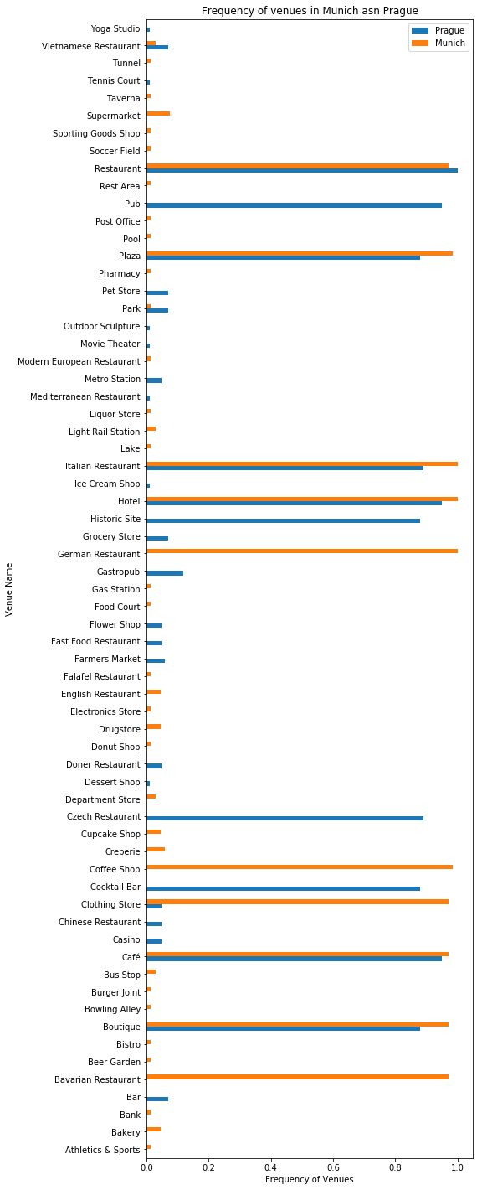
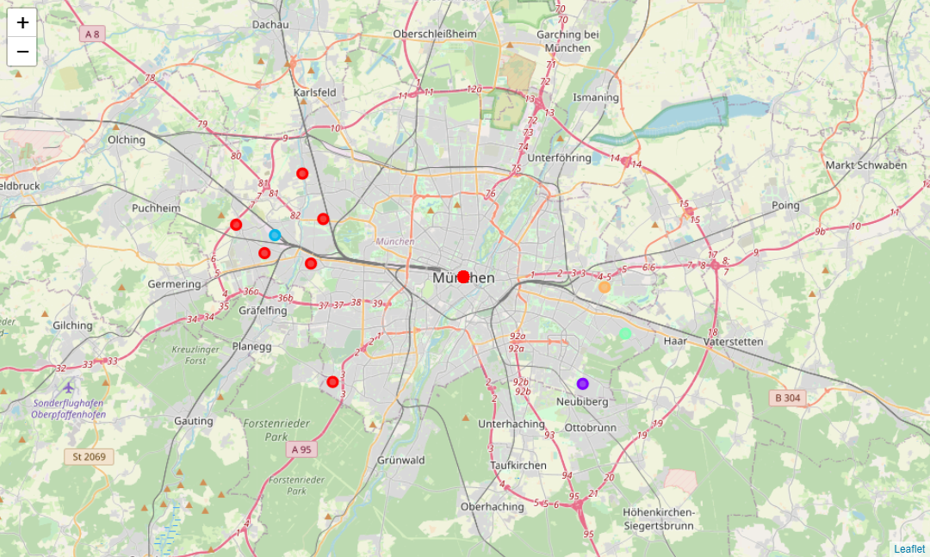
Results

Slide 9
Discussion
Only 9 from 65 venues are the same in both cities!
Munic has more unique venues than Prague.
The API uses different names fo the same venues

Slide 10
Conclusion
Munich is more multicultural. It can also be expected, that in Prague will emerge demand on more luxurious “unnecessary” services, as Prague’s wealth level will converge to Munich’s.
Prague is also stronger in Farmers Markets which could also be interesting for Munich.

